Slide 1
Agents in AI
1

Slide 2
Outline
2
Agents and environments
Rationality
PEAS (Performance measure, Environment, Actuators, Sensors)
Environment types
Agent types

Slide 3
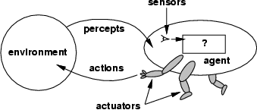
Agents
3
An agent is anything that can be viewed as
perceiving its environment through sensors and
acting upon that environment through actuators
Assumption: Every agent can perceive its own actions (but not always the effects)

Slide 4
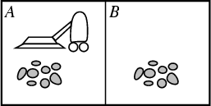
Example: Vacuum-Agent
4
Percepts:
Location and status, e.g., [A,Dirty]
Actions:
Left, Right, Suck, NoOp
function Vacuum-Agent([location,status]) returns an action
if status = Dirty then return Suck
else if location = A then return Right
else if location = B then return Left

Slide 5
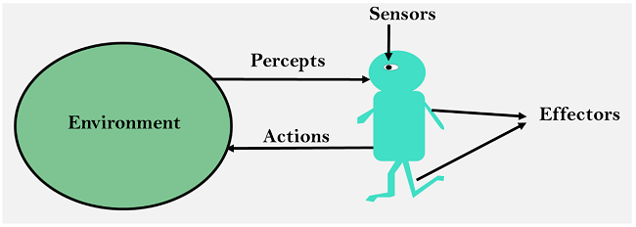
Sensor: Sensor is a device which detects the change in the environment and sends the information to other electronic devices. An agent observes its environment through sensors.
Actuators: Actuators are the component of machines that converts energy into motion. The actuators are only responsible for moving and controlling a system. An actuator can be an electric motor, gears, rails, etc.
Effectors: Effectors are the devices which affect the environment. Effectors can be legs, wheels, arms, fingers, wings, fins, and display screen.

Slide 6
Agents
5
Human agent:
eyes, ears, and other organs for sensors;
hands,legs, mouth, and other body parts for actuators
Robotic agent:
cameras and infrared range finders for sensors;
various motors for actuators
A software agent:
Keystrokes, file contents, received network packages as sensors
Displays on the screen, files, sent network packets as actuators

Slide 7
Intelligent Agents
An intelligent agent is an autonomous entity which act upon an environment using sensors and actuators for achieving goals. An intelligent agent may learn from the environment to achieve their goals. A thermostat is an example of an intelligent agent.
Following are the main four rules for an AI agent:
Rule 1: An AI agent must have the ability to perceive the environment.
Rule 2: The observation must be used to make decisions.
Rule 3: Decision should result in an action.
Rule 4: The action taken by an AI agent must be a rational action.

Slide 8
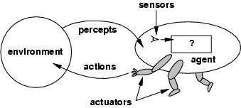
Terminologies
Percept: the agent’s perceptual inputs
Percept sequence: the complete history of everything the agent has perceived
Agent function maps any given percept sequence to an action [f: p* -> A]
The agent program runs on the physical architecture to produce f
Agent = architecture + program

Slide 9

Vacuum-Cleaner World
Percepts: location and contents, e.g., [A, dirty]
Actions: Left, Right, Suck, NoOp

Slide 10
A Simple Agent Function
Percept sequence | Action
[A, Clean]
[A, Dirty]
[B, Clean]
[B, Dirty]
[A, Clean], [A, Clean]
[A, Clean], [A, Dirty]
…
[A, Clean], [A, Clean], [A, Clean]
[A, Clean], [A, Clean], [A, Dirty]
…
Right
Suck Left Suck Right Suck
… Right Suck
…

Slide 11
Rationality
An agent should "do the right thing", based on what it can perceive and the actions it can perform. The right action is the one that will cause the agent to be most successful
Performance measure: An objective criterion for success of an agent's behavior
Back to the vacuum-cleaner example
■ Amount of dirt cleaned within certain time
■ +1 credit for each clean square per unit time
General rule: measure what one wants rather than how one thinks the agent should behave

Slide 12
Rational Agent
■ Definition:
■ For each possible percept sequence, a rational agent should select an action that is expected to maximize its performance measure, given the evidence provided by the percept sequence and whatever built-in knowledge the agent has.

Slide 13
Vacuum–Cleaner Example
A simple agent that cleans a square if it is dirty and moves to the other square if not
Is it rational?
Assumption:
performance measure: 1 point for each clean square at each time step
environment is known a priori
actions = {left, right, suck, no-op}
agent is able to perceive the location and dirt in that location

Slide 14
Specifying the task environment (PEAS)
14
PEAS:
Performance measure,
Environment,
Actuators,
Sensors
In designing an agent, the first step must always be to specify the task environment (PEAS) as fully as possible

Slide 15
Specifying the task environment
15
PEAS: Performance measure, Environment, Actuators, Sensors
P: a function the agent is maximizing (or minimizing)
Assumed given
In practice, needs to be computed somewhere
E: a formal representation for world states
For concreteness, a tuple (var₁=val₁, var₂=val₂, … ,var_{n}=val_{n})
A: actions that change the state according to a transition model
Given a state and action, what is the successor state (or distribution over successor states)?
S: observations that allow the agent to infer the world state
Often come in very different form than the state itself
E.g., in tracking, observations may be pixels and state variables 3D coordinates

Slide 16
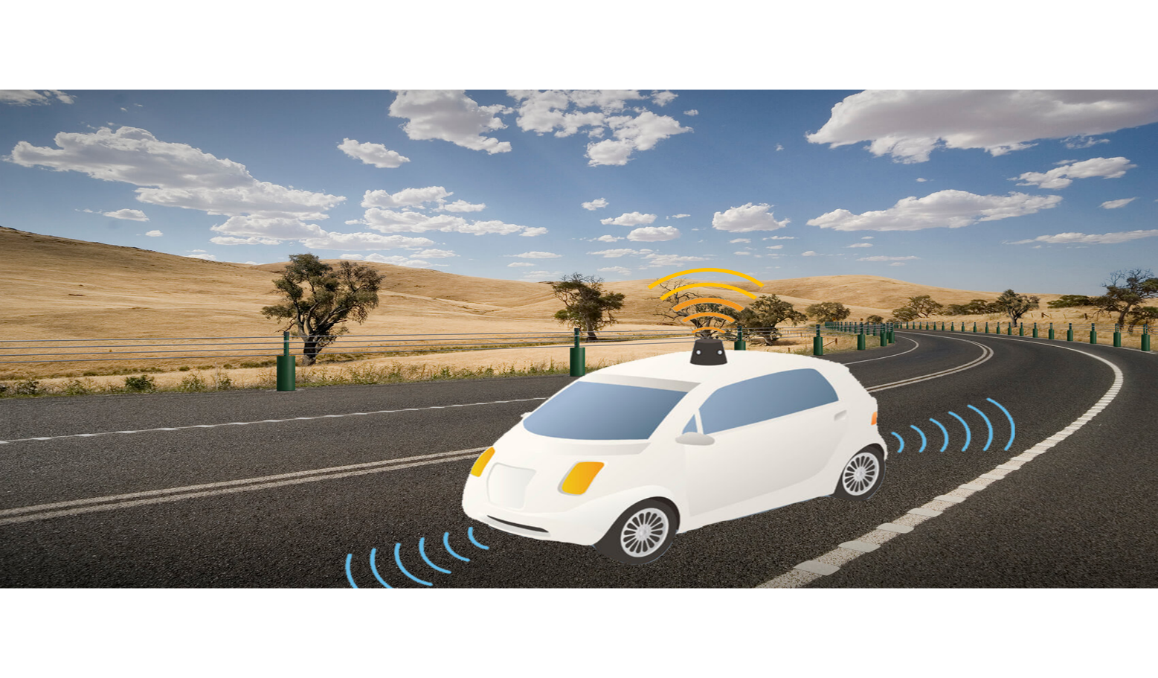
PEAS Example: Autonomous taxi

Slide 17
PEAS Example: Autonomous taxi
16
Performance measure
Safe, fast, legal, comfortable trip, maximize profits
Environment
Roads, other traffic, pedestrians, customers
Actuators
Steering wheel, accelerator, brake, signal, horn
Sensors
Cameras, LIDAR, speedometer, GPS, odometer, engine sensors, keyboard

Slide 18
Another PEAS example: Spam filter
17
Performance measure
Minimizing false positives, false negatives
Environment
A user’s email account, email server
Actuators
Mark as spam, delete, etc.
Sensors
Incoming messages, other information about user’s account

Slide 19
PEAS for a medical diagnosis system
18
Performance measure:
Environment:
Actuators:
Sensors:

Slide 20
PEAS for a medical diagnosis system
18
Performance measure: Healthy patient, minimize costs, lawsuits
Environment: Patient, hospital, staff
Actuators: Screen display (questions, tests, diagnoses, treatments,
referrals)
Sensors: Keyboard (entry of symptoms, findings, patient's
answers)

Slide 21
PEAS for a refinery controller
21
Performance measure:
Environment:
Actuators:
Sensors:

Slide 22
PEAS for a refinery controller
21
Performance measure: maximize purity, yield, safety
Environment: refinery, operators
Actuators: valves, pumps, heaters, displays
Sensors: temperature, pressure, chemical sensors

Slide 23
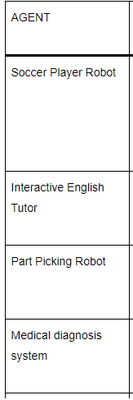

Slide 24
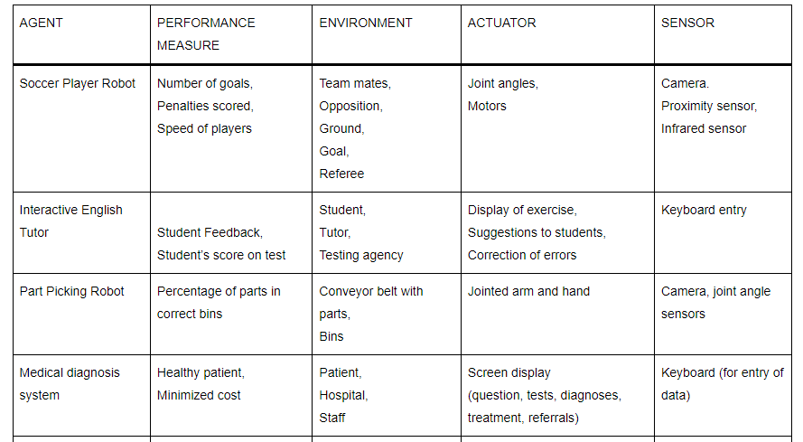

Slide 25
Environment types
24
Fully observable vs. partially observable
Deterministic vs. stochastic
Episodic vs. sequential
Static vs. dynamic
Discrete vs. continuous
Single agent vs. multiagent

Slide 26
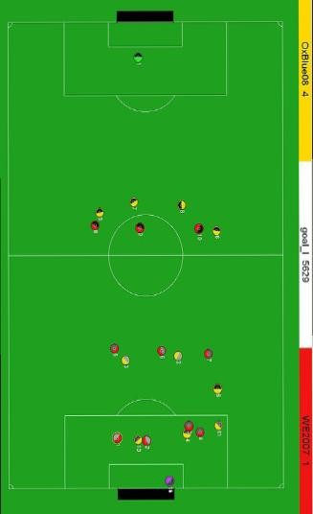
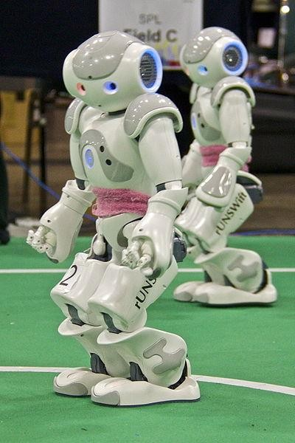
Environment types
25
Fully observable vs. partially observable:
An environment is fully observable if an agent's sensors give it access to the complete state of the environment at each point in time.
Fully observable environments are convenient, because the agent need not maintain any internal state to keep track of the world
An environment might be partially observable because of noisy and inaccurate sensors or because parts of the state are simply missing from the sensor data
Examples: vacuum cleaner with local dirt sensor, taxi driver

Slide 27
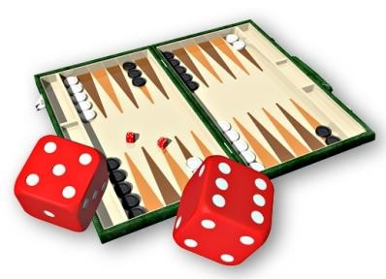
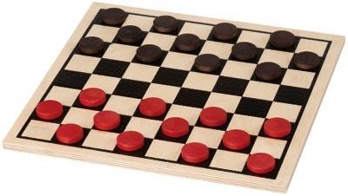
Environment types
26
Deterministic vs. stochastic:
The environment is deterministic if the next state of the environment is completely determined by the current state and the action executed by the agent.
In principle, an agent need not worry about uncertainty in a fully observable, deterministic environment
If the environment is partially observable then it could
appear to be stochastic
Examples: Vacuum world is deterministic while taxi driver is not

Slide 28
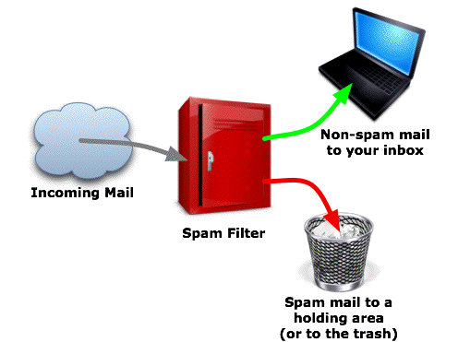
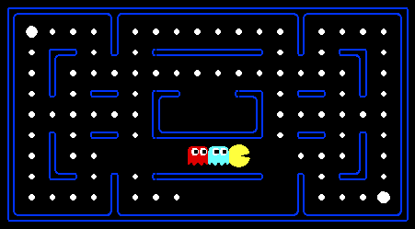
Environment types
27
Episodic vs. sequential:
In episodic environments, the agent's experience is divided into atomic "episodes" (each episode consists of the agent perceiving and then performing a single action), and the choice of action in each episode depends only on the episode itself.
Examples: classification tasks
In sequential environments, the current decision could affect all future decisions
Examples: chess and taxi driver

Slide 29
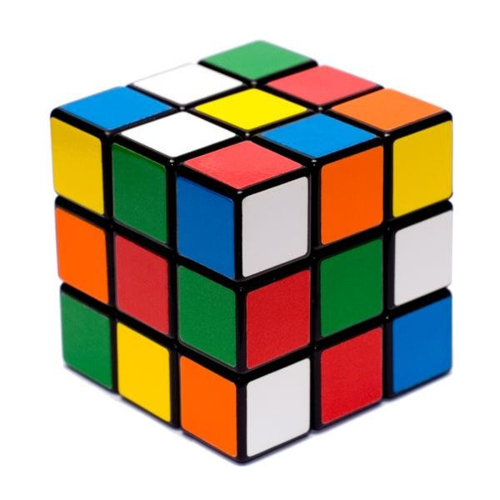
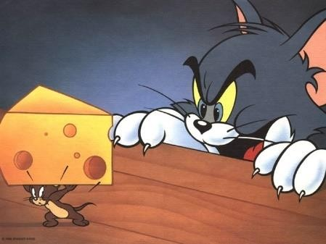
Environment types
28
Static vs. dynamic:
The environment is unchanged while an agent is deliberating.
Static environments are easy to deal with because the agent need not keep looking at the world while it is deciding on the action or need it worry about the passage of time
Dynamic environments continuously ask the agent what it wants to do
The environment is semi-dynamic if the environment itself does not change with the passage of time but the agent's performance score does
Examples: taxi driving is dynamic, chess when played with a clock is semi-dynamic, crossword puzzles are static

Slide 30
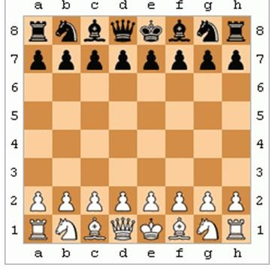
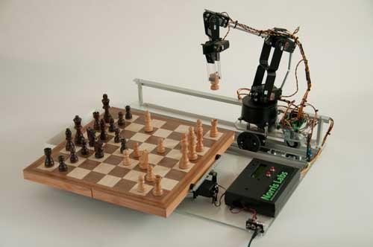
Environment types
29
Discrete vs. continuous:
A limited number of distinct, clearly defined states, percepts and
actions.
Examples: Chess has finite number of discrete states, and has discrete set of percepts and actions. Taxi driving has continuous states, and actions

Slide 31
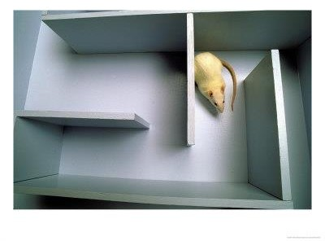
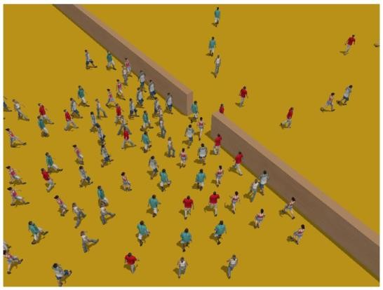
Environment types
30
Single agent vs. multiagent:
An agent operating by itself in an environment is single agent
Examples: Crossword is a single agent while chess is two-agents
Question: Does an agent A have to treat an object B as an agent or can it be treated as a stochastically behaving object
Whether B's behaviour is best described by as maximizing a
performance measure whose value depends on agent's A behaviour
Examples: chess is a competitive multiagent environment while taxi driving is a partially cooperative multiagent environment

Slide 32
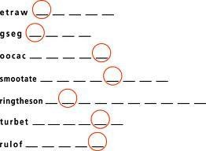
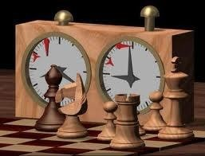
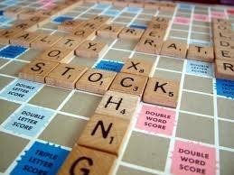
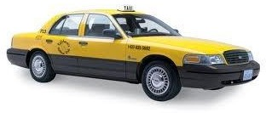
Examples of different environments
32
Word jumble
solver
Chess with
a clock
Scrabble
Autonomous
driving
Observable
Fully
Fully
Partially
Partially
Deterministic
Deterministic
Strategic
Stochastic
Stochastic
Sequential
Episodic
Episodic
Sequential
Sequential
Static
Static
Semidynamic
Static
Discrete
Dynamic
Discrete
Discrete
Continuous
Discrete
Single agent
Single
Multi
Multi
Multi

Slide 33
task environm. | observable | determ./ stochastic | episodic/ sequential | static/ dynamic | discrete/ continuous | agents
crossword puzzle
chess with clock
poker
back gammon
taxi driving
medical diagnosis
image analysis
partpicking robot
refinery controller

Slide 34
Agent functions and programs
34
An agent is completely specified by the agent function mapping percept sequences to actions
One agent function (or a small equivalence class) is rational
Aim: find a way to implement the rational agent function concisely -> design an agent program
Agent = agent program + architecture
Architecture: some sort of computing device with physical sensors and actuators (PC, robotic car)
– should be appropriate: walk action requires legs

Slide 35
Agent functions and programs
35
Agent program:
Takes the current percept as input from the sensors
Return an action to the actuators
While agent function takes the whole percept history, agent program takes just the current percept as input which the only available input from the environment
The agent need to remember the whole percept
sequence, if it needs it

Slide 36
Agent types
37
Rather than a table how we can produce rational behavior from a small amount of code
Four basic types in order of increasing generality:
Simple reflex agents
Model-based reflex agents
Goal-based agents
Utility-based agents

Slide 37
Simple reflex agents
38
Select actions on the basis of the current percept ignoring the rest of the percept history
Example: simple reflex vacuum cleaner agent
function REFLEX-VACUUM-AGENT([location,status]) returns an action
if status = Dirty then return Suck
else if location = A then return Right
else if location = B then return Left
Condition-action-rule
Example: if car-in-front-is-breaking then initiate-breaking

Slide 38
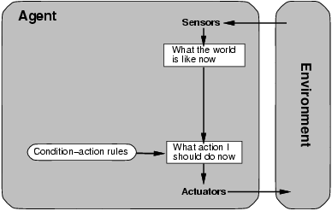
Simple reflex agents
39

Slide 39
Simple reflex agents
40
function SIMPLE-REFLEX-AGENT(percept) returns an action
static: rules, a set if condition-action rules state <-- INTERPRET_INPUT(percept) rule <-- RULE_MATCH(state, rules) action <-- RULE_ACTION[rule]
return action
Simple-reflex agents are simple, but they turn out to be of very limited intelligence
The agent will work only if the correct decision can be made on the basis of the current percept – that is only if the environment is fully observable
Infinite loops are often unavoidable – escape could be possible by randomizing

Slide 40
Model-based reflex agents
41
The agent should keep track of the part of the world it can't see now
The agent should maintain some sort of internal state that depends on the percept history and reflects at least some of the unobserved aspects of the current state
Updating the internal state information as time goes by requires two kinds of knowledge to be encoded in the agent program
Information about how the world evolves independently of the agent
Information about how the agent's own actions affects the world
Model of the world – model based agents

Slide 41
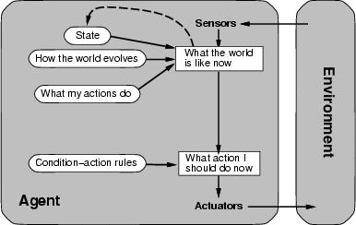
Model-based reflex agents
42

Slide 42
Model-based reflex agents
43
function REFLEX-AGENT-WITH-STATE(percept) returns an action
static: state, a description of the current world state
rules, a set of condition-action rules
action, the most recent action, initially none
state <-- UPDATE_INPUT(state, action, percept)
rule <-- RULE_MATCH(state, rules) action <-- RULE_ACTION[rule] return action

Slide 43
Goal-based agents
44
Knowing about the current state of the environment is not always enough to decide what to do (e.g. decision at a road junction)
The agent needs some sort of goal information that describes situations that are desirable
The agent program can combine this with information about the results of possible actions in order to choose actions that achieve the goal
Usually requires search and planning

Slide 44
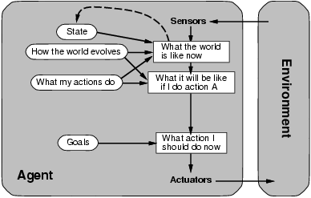
Goal-based agents
45

Slide 45
Goal-based agents vs reflex-based agents
46
Although goal-based agents appears less efficient, it is more flexible because the knowledge that supports its decision is represented explicitly and can be modified
On the other hand, for the reflex-agent, we would have to rewrite many condition-action rules
The goal based agent's behavior can easily be changed
The reflex agent's rules must be changed for a new situation

Slide 46
Utility-based agents
47
Goals alone are not really enough to generate high quality behavior in most environments – they just provide a binary distinction between happy and unhappy states
A more general performance measure should allow a comparison of different world states according to exactly how happy they would make the agent if they could be achieved
Happy – Utility (the quality of being useful)
A utility function maps a state onto a real number which describes the associated degree of happiness

Slide 47
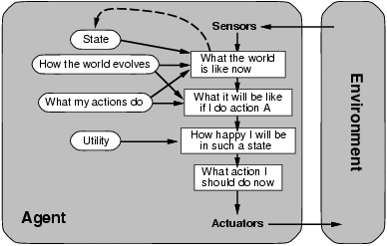
Utility-based agents
48

Slide 48
Learning agents
49
Turing – instead of actually programming intelligent machines by hand, which is too much work, build learning machines and then teach them
Learning also allows the agent to operate in initially unknown environments and to become more competent than its initial knowledge alone might allow

Slide 49
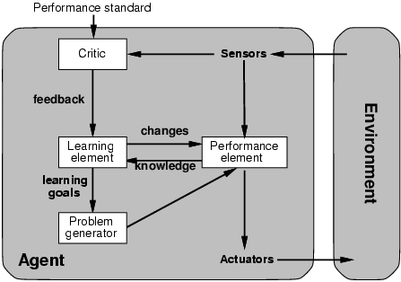
Learning agents
50

Slide 50
Learning agents
51
Learning element – responsible for making improvements
Performance element – responsible for selecting external actions (it is what we had defined as the entire agent before)
Learning element uses feedback from the critic on how the agent is doing and determines how the performance element should be modified to do better in the future
Problem generator is responsible for suggesting actions that will lead to a new and informative experiences

Slide 51
SUMMARY
The agent function describes what the agent does in all circumstances
The performance measure evaluates the environment sequence
A perfectly rational agent maximizes expected performance Agent programs implement (some) agent functions PEAS descriptions define task environments
Environments are categorized along several dimensions: observable? deterministic? episodic? static? discrete? single-agent?
Several basic agent architectures exist: reflex, reflex with state, goal-based, utility-based

